Slide 1
Chapter 1:
What is Happiness?
Happiness and Health…a two way street!

Slide 2

Happiness and Wellbeing
Happiness tends to

Slide 3
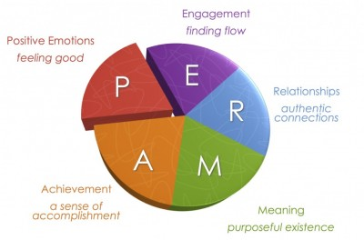
The PERMA Model of Wellbeing
Martin Seligman defines five core element of psychological well-being and happiness. He believes that these five elements can help people reach a life of fulfillment, happiness, and meaning

Slide 4
PERMA and Strands of Wellbeing
Common Ground
PERMA: Seligman
Three Strands: Beutner
Positive Emotions: ability to be optimistic. Enjoyment focus.
Engagement: Doing things that enhance flow. Hobbies, arts etc.
Relationships: Love intimacy, strong emotional and physical interaction
Meaning: Finding and living with purpose in your life
Accomplishment: Setting and reaching realistic goals
Pleasure: Sum of moments of experienced happiness/enjoyment
Purpose: Life that involves greater meaning and in service to the greater good
Pride: Personal satisfaction with accomplishments and where you are at this stage in your life.

Slide 5
Positive Psychology: The Happy Life
Examining Life: Pleasant Life, The Good life (engagement), Meaningful Life.
video link (click here) (this link is also in your module and prei, but in case you missed this….

Slide 6
From the Video: Martin Seligman – Positive Psychology
What are the challenges of each specific type of life?
Can we be happy in a specific type of life when other aspects are somewhat absent?
When does flow occur and why does it matter? If is the same for all or can we find flow in many different ways?
How is knowing our strengths enhance our happy life?
What skills can we use to enhance the pleasures, meaning and satisfaction in our life?
Which type of life matters most and why? Which make the greatest contribution to life satisfaction?
What about health and productivity? Does a life with meaning and engagement enhance each?
Why do we need to be optimistic?

Slide 7
Happiness/Wellbeing and Health
Look for the common ground between the two visuals on the next slide

Slide 8
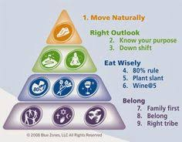
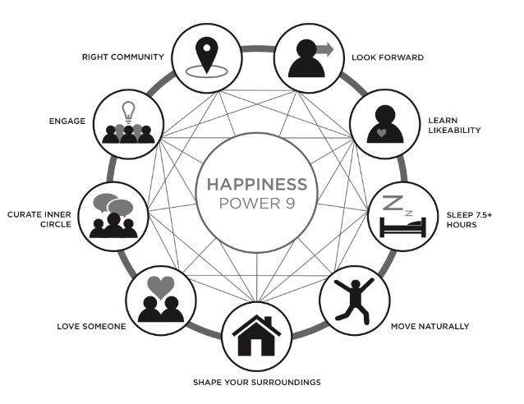
The Road to Discovery:
Blue Zones (longevity Hot Spots and Happy Zones)

Slide 9
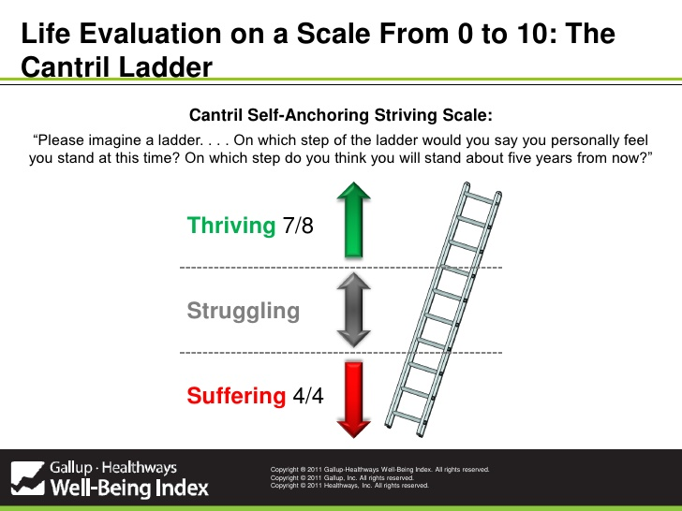
Evaluating self:
Reliable measurement

Slide 10
Moving up the Cantrell Ladder: How can you move up to the next level?
Thriving — wellbeing that is strong, consistent, and progressing. These respondents have positive views of their present life situation (7+) and have positive views of the next five years (8+). They report significantly fewer health problems, fewer sick days, less worry, stress, sadness, anger, and more happiness, enjoyment, interest, and respect.
Struggling — wellbeing that is moderate or inconsistent. These respondents have moderate views of their present life situation OR moderate OR negative views of their future. They are either struggling in the present, or expect to struggle in the future. They report more daily stress and worry about money than the “thriving” respondents, and more than double the amount of sick days. They are more likely to smoke, and are less likely to eat healthy.
Suffering — wellbeing that is at high risk. These respondents have poor ratings of their current life situation (4 and below) AND negative views of the next five years (4 and below). They are more likely to report lacking the basics of food and shelter, more likely to have physical pain, a lot of stress, worry, sadness, and anger. They have less access to health insurance and care, and more than double the disease burden, in comparison to “thriving” respondents.

Slide 11
Gallop Wellbeing
Ask questions about
  Previous day feelings (pleasure strand) related to experiencing self)
  Worthwhile nature of their life (purpose and/or pride strand)

Slide 12
Results of polls differ as to questions asked but commonalities exist in terms of human needs.
Maslow’s Hierarchy of needs
1. Basics in life,
2. Individual esteem and cognitive growth
3. Growth of spirit through self actualization and transcendence,

Slide 13
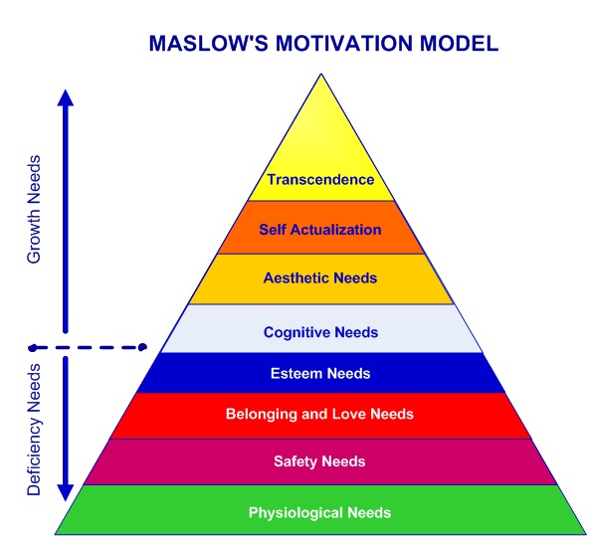
Basic needs of Maslow’s
Hierarchy must be met first.

Slide 14

Money and Happiness
For overall mood and positive emotions, income of
75,000 for a family of four is the threshold. This varies
little with more income.
Our sense of doing well does go up as we earn more.

Slide 15
Next Stop
Chapter two: What we know about Happiness.

